Slide 1

Bike Sharing Incentive Project

Slide 2

Background
Bike sharing systems are new generation of traditional bike rentals where whole process from membership, rental and return back has become automatic.
Example

Slide 3

As the Operator
You want to :
Maximum utilisation of the service during lean demand periods which can facilitate the goal of increasing the share of bike mode as means of travel.
You notice:
Bike sharing service has different demand cycles.

Slide 4
Bike Sharing Incentive Scheme
Using the dataset provided to build the incentive scheme
Incentive can be monetary or non-monetary, so as to encourage people to take up bike sharing.
To develop such a scheme, it is essential to understand when users choose to/not to use the service

Slide 5
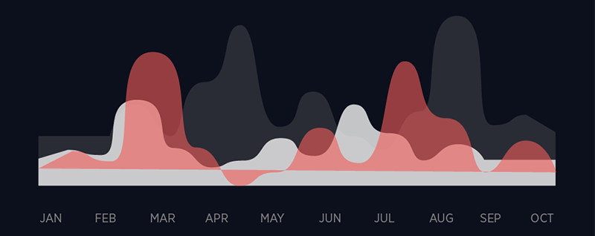
Dataset
A data set containing two-year historical log corresponding to years 2011 and 2012.
Kindly refer to the folder “Bike Sharing Incentive Data”

Slide 6
Dataset contains following variables :
• instant: record index • dteday : date • season : season (1:spring, 2:summer, 3:fall, 4:winter) • yr : year (0: 2011, 1:2012)
• mnth : month ( 1 to 12) • hr : hour (0 to 23)

Slide 7
Dataset contains following variables (cont)
• holiday : whether day is holiday or not • weekday : day of the week • workingday : if day is neither weekend nor holiday = 1, otherwise =0
• weathersit : - 1: Clear, Few clouds, Partly cloudy, Partly cloudy - 2: Mist + Cloudy, Mist + Broken clouds, Mist + Few clouds, Mist - 3: Light Snow, Light Rain + Thunderstorm + Scattered clouds, Light Rain + Scattered clouds - 4: Heavy Rain + Ice Pallets + Thunderstorm + Mist, Snow + Fog

Slide 8
Dataset contains following variables (cont)
temp : Normalized temperature in Celsius. The values are divided to 41 (max)
atemp: Normalized feeling temperature in Celsius. The values are divided to 50 (max)
hum: Normalized humidity. The values are divided to 100 (max)
windspeed: Normalized wind speed. The values are divided to 67 (max)
casual: count of casual users
registered: count of registered users
cnt: count of total rental bikes including both casual and registered

Slide 9

Requirements
Teamwork : Maximum 3 members
Data Cleaning & Processing : Detecting and correcting (or removing) corrupt or Inaccurate records that may distort the results.
Visualization: Use suitable graphs/visualisations to explore the given data. Explain how these visualisations will be useful in developing a suitable incentive scheme.
Data Modeling: Identify the factors that have impact on the demand for bike sharing services and suggest an incentive scheme based on your observations.

Slide 10

Optional
You may choose to extract additional contextual information through the web (like events) which might improve the scheme.
Sharing Features engineered which are hypothesized in your data modeling. Note: Feature Engineering contribute the highest to a better prediction. https://en.wikipedia.org/wiki/Feature_engineering

Slide 11

Submission
Fill in your team member’s name here
Submit your presentation slides and R code(including the code to process/clean the data) here under your group folder by 8 April
We have prize for winning tram!

